Slide 1
嵌入式系統設計與實務
授課教師：逢甲大學 資訊工程系 陳德生老師、王益文老師

Slide 2
第 13 週
UART
- UART, 7-Seg, LCD, Keypad

Slide 3
UART (Universal Asynchronous Receiver Transimitter)
Drive
Drive
Drive
Drive
Drive
Drive
Drive
Drive
Drive
Drive
Drive
Serial
Transmit
Start
Bit
Data
Bit 0
Data
Bit 1
Data
Bit 2
Data
Bit 3
Data
Bit 4
Data
Bit 5
Data
Bit 6
Data
Bit 7
Parity
Bit
Stop
Bit
LSB
MSB
Sample
Sample
Sample
Sample
Sample
Sample
Sample
Sample
Sample
Sample
Sample
Serial
Receive
Start
Bit
Data
Bit 0
Data
Bit 1
Data
Bit 2
Data
Bit 3
Data
Bit 4
Data
Bit 5
Data
Bit 6
Data
Bit 7
Parity
Bit
Stop
Bit
LSB
MSB

Slide 4
RS-232 DB9 Connector
1
Data Carrier Detect
6
Data Set Ready
2
Receive Data
7
Request To Send
3
Transmit Data
8
Clear To Send
4
Data Terminal Ready
9
Ring Indicator
5
Signal Ground

Slide 5
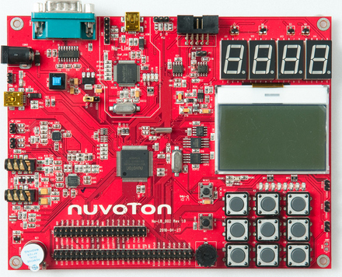
Nu-LB-NUC140 UART w RS232 transceiver
RS232
connector
RS232
Transceiver

Slide 6
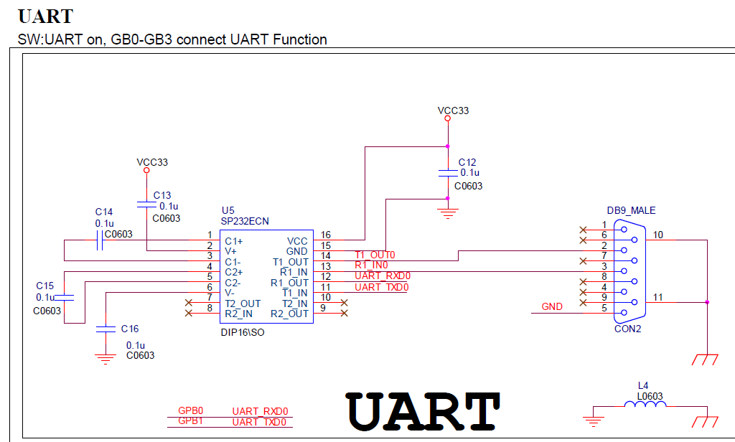
UART schematic
SP232-TX
to DB9 pin2 RX
SP232-RX
from DB9 pin3 TX

Slide 7
NuMicro MCU UARTs
3 UART ports
programmable baud-rate
programmable serial-interface
Built-in TX/RX buffers (FIFO) : 16 bytes
Support hardware flow-control (/CTS 及 /RTS) on UART0 & UART1
Support IrDA SIR function (Infrared transmission use)
Pin Connections :
UART0-RX = GPB0, UART0-TX = GPB1
UART1-RX=GPB4, UART1-TX=GPB5
UART2-RX=GPD14, UART2-TX=GPD15

Slide 8
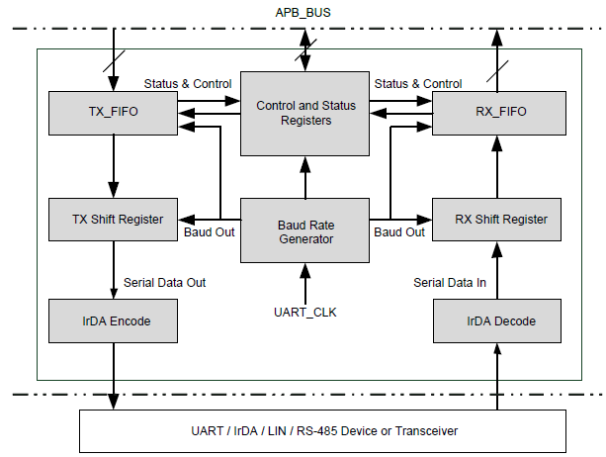
UART Block Diagram

Slide 9
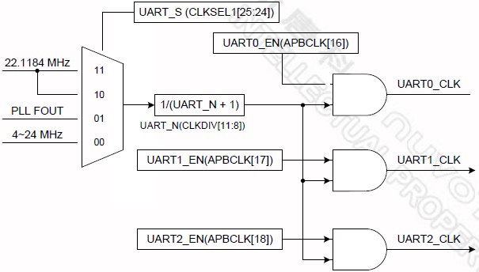
UART Clock Selection of NUC140
HIRC
PLL
HXT

Slide 10
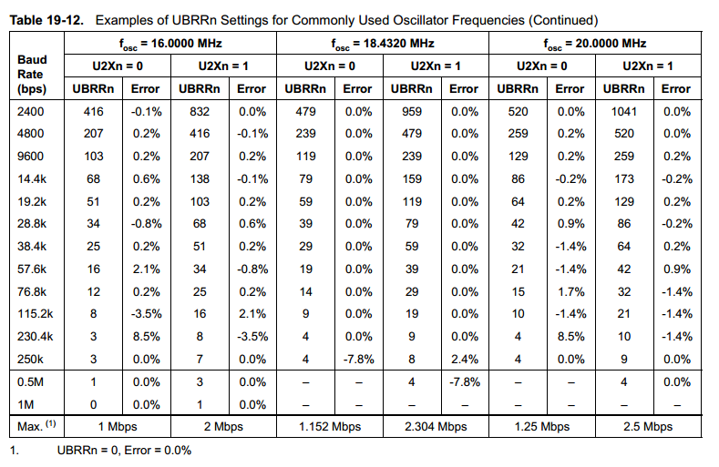

UART Baud Rate Setting vs Oscillator Frequencies

Slide 11
UART function calls
UART_Open(UARTn, Baudrate);
UART_Open(UART1, 9600);
UART_Read(UARTn, ReadBuffer, No_of_bytes);
UART_Read(UART1, RX_Buffer, 8);
UART_READ(UART1); // read 1 byte
UART_Write(UARTn, WriteBuffer, No_of_bytes);
UART_Write(UART1, TX_Buffer, 8);
UART_WRITE(UART1, out_data); // write 1 byte

Slide 12
UART Port & INT Initialization
void Init_HC06(void)
{
UART_Open(UART1, 9600); // enable UART1 at 9600 baudrate
UART_ENABLE_INT(UART1, UART_IER_RDA_IE_Msk);
NVIC_EnableIRQ(UART1_IRQn);
}

Slide 13
UART IRQ Handler
#define RXBUFSIZE 8
volatile char RX_buffer[RXBUFSIZE];
void UART1_IRQHandler(void)
{
uint32_t u32IntSts= UART1->ISR; // UART interrupt status bit
if(u32IntSts & UART_IS_RX_READY(UART1)) {
UART_Read(UART1, RX_buffer, RXBUFSIZE);
}
}

Slide 14
UART Protocol Setting
Even, odd or no-parity
5 ~ 8bits
1 ~ 2bits
UART_SetLine_Config(WORD_LEN_8, PARITY_NONE, STOP_BIT_1)
uart-> LCR = UART_WORD_LEN_8 |
UART_PARITY_NONE |
UART_STOP_BIT_1;

Slide 15
Keil Demo
UART, 7-Seg, LCD, Keypad
3

Slide 16
Practice
Sender
Keypad gets the number
7-Seg displays the number
UART transmits the number
Receiver
UART gets the number
LCD displays the number
Loopback testing
Sender and Receiver could be the same.
123456
1
2
3
4
5
5
6
7
8
9

Slide 17
C Codes : UART IRQHandler to receive
void UART02_IRQHandler(void)
{
uint8_t c;
uint32_t u32IntSts = UART0->ISR;
if( u32IntSts & UART_IS_RX_READY(UART0)) { // check ISR on & RX is ready
while (!(UART0->FSR & UART_FSR_RX_EMPTY_Msk)) { // check RX not empty
c = UART_READ(UART0); // read 1 byte from UART RX
if (c!= '0') {
printC(8*count_Char, 16*(count_Line%4), c); // LCD display
if (++count_Char ==16){count_Char =0; count_Line++; }
}
}
}
}
17

Slide 18
C Codes : key a number to send
int32_t main()
{
Initialize all MCU Interfaces;
Init_UART();
while(1) {
if (KEY_Flag !=0) {
digit[3] = digit[2];
digit[2] = digit[1];
digit[1] = digit[0];
digit[0] = KEY_Flag; // store KEY number in digit[0]
KEY_Flag =0;
ASSCII = digit[0]+48;
UART_Write(UART0, &ASSCII, 1); }
}
}
18

Slide 19
版權聲明
素材內容 | 引用來源 | 授權說明
PPT | https://drive.google.com/drive/folders/1dwAL_a18o_VV9iBkfLwzhcTKHnRy5K9S?usp=sharing 郭子仁 MCU Interfaces & Driver Design 2020

Slide 20

有著作權，侵害必究©逢甲大學
Copyright@Feng Chia University

